Slide 1


Vehicle Monitoring & Route Analysis System
By Tommy Condon & Finn Bennett
IoT Standards & Protocols Project
May 2024

Slide 2

Project Outline
Monitors car atmosphere using SenseHat sensors (temperature, humidity, pressure etc)
Route analysis using GPS coordinates from GPS tracker/module.
Gives 7 day average of stats such as:
Temperature inside vehicle
Humidity inside vehicle
Route analysis
Distance covered

Slide 3








Services / Equipment
API

Slide 4
Device Representation (in theory) (Block level)
SBC
SenseHAT
Serial USB
GPS Module (Pycom)

Slide 5
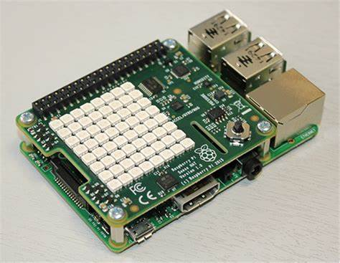


Process
Retrieves data from SenseHat and GPS module
GPS latitude and longitude coordinates interpreted using reverse geocoding
Store in NoSQL database (MongoDB)
Send to frontend (Blynk)

Slide 6
Different use cases
Tracking mileage done per week
Temperature in vehicle (too hot, too cold)
Pressure in vehicle (PA)
Location monitoring
Direction indicator

Slide 7
Cycling Use Case
Could be used for cycling
Garmin Speed Sensor, Heart rate monitor using BLE/ANT+
Use dashboard to display data

Slide 8
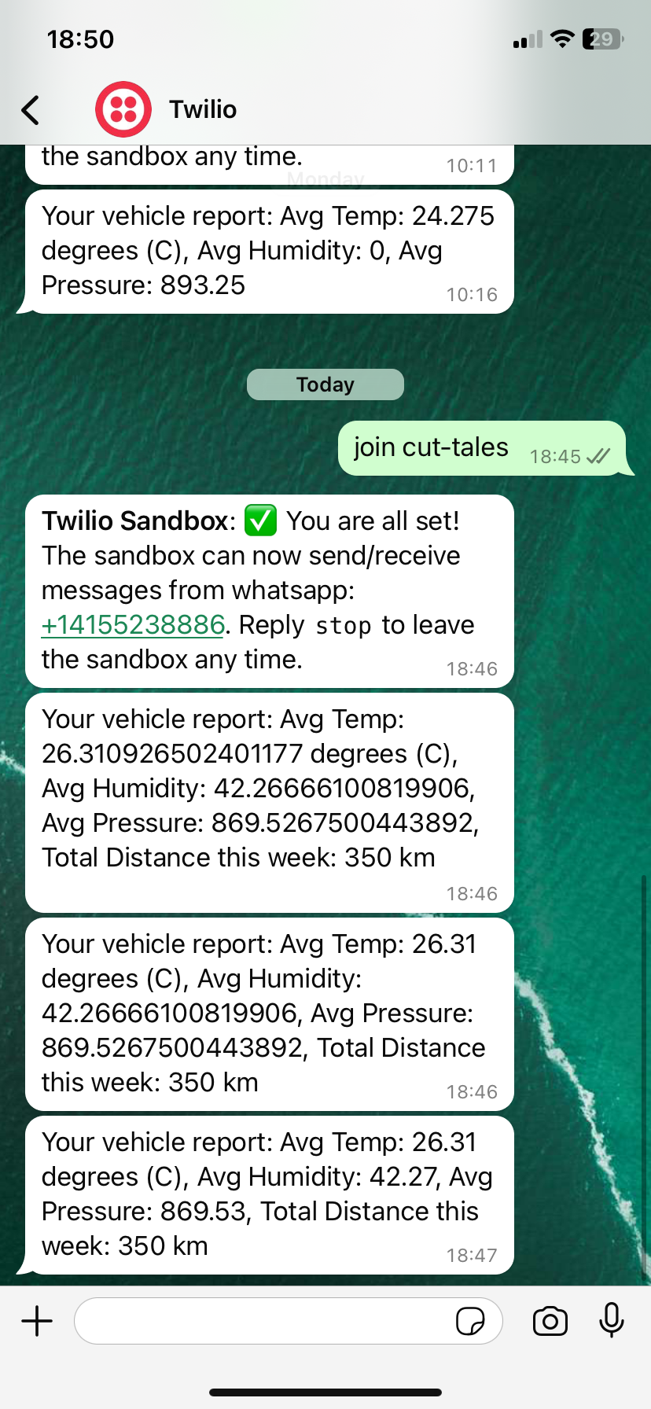
Must send message ‘join cut-tales’ to Twilio number to activate connection
Data shown here not great (messy)
We can round the data up to 2 decimal places using ‘round(field,2)’

Slide 9


Slide 10
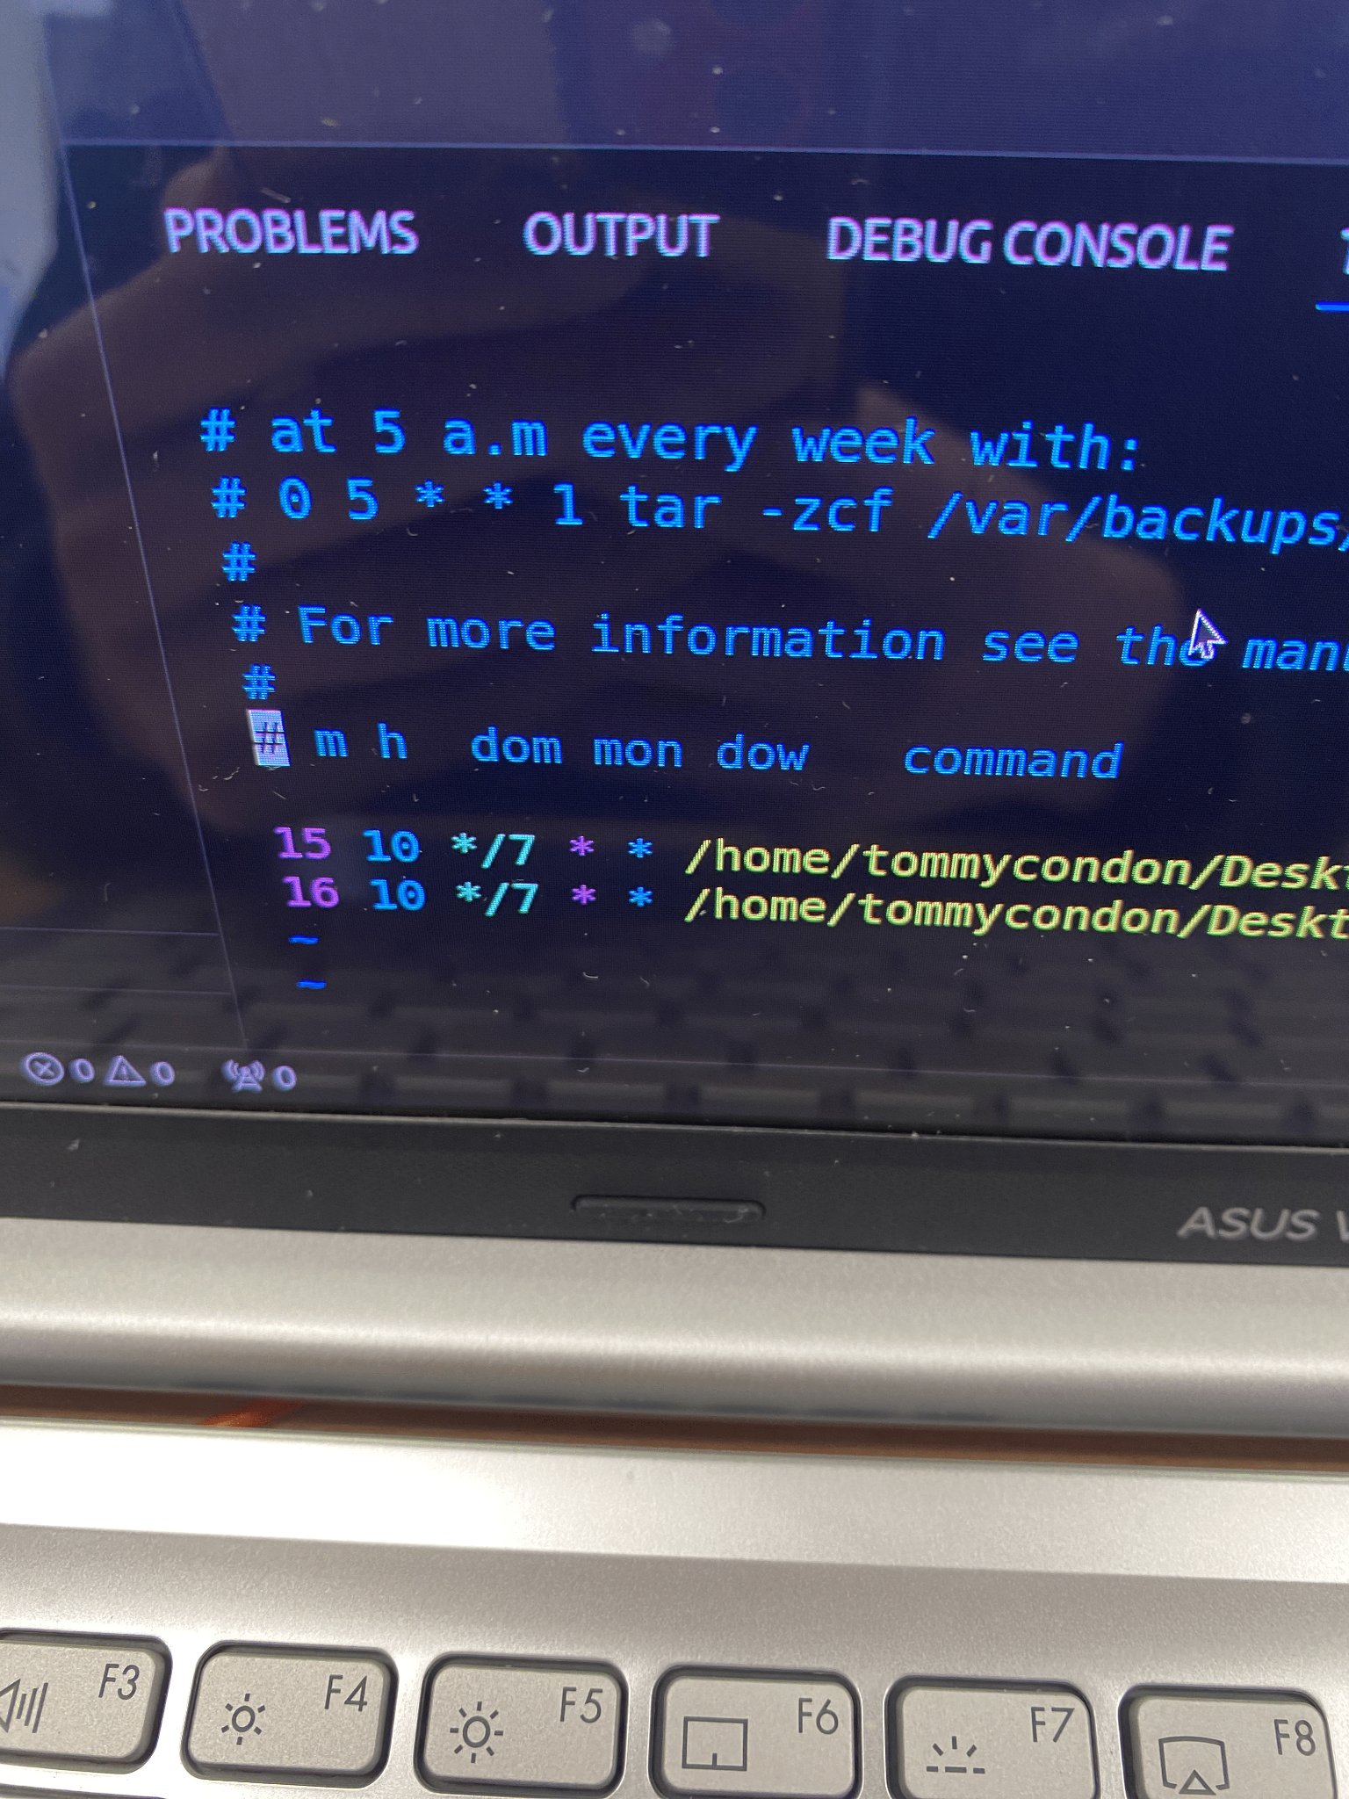
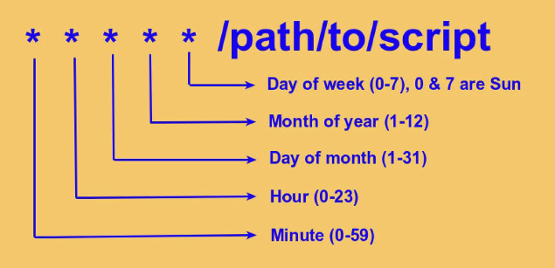
Cron job scheduling
A cron-job is a task scheduled for a certain time/day/month/year
Scheduled to run at specific moment in time
Source: RedHat

Slide 11
Thanks!
Do you have any questions?

